Slide 1


Slide 2

What on earth are apprenticeships?
There are many apprenticeships that link to Geography.
Today we are going to explore some of the different apprenticeships.
We’re going to start by watching a film about apprentices working in roles that help the environment.

Slide 3

Notes:
To access this film visit https://vimeo.com/765659591
For more resources on green apprenticeships, please visit https://amazingapprenticeships.com/green-careers-week/

Slide 4

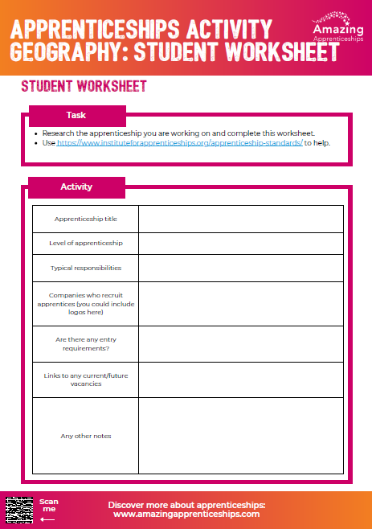
Geography related apprenticeships:
Arboriculturist
Energy manager
Town planner
Countryside ranger
Forest craftsperson
Landscape technician
Crop technician
Geospatial mapper

Slide 5
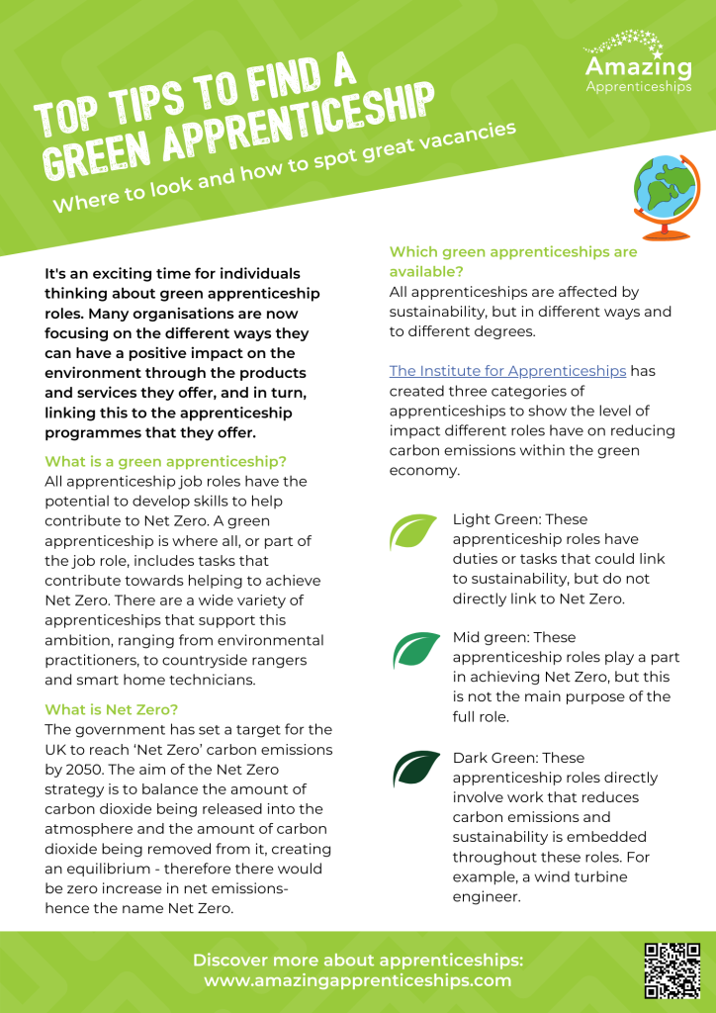
Home Learning
Choose one apprenticeship that you have heard about today either through the activity, or within the Green film.
Create one PowerPoint slide to raise awareness of the apprenticeship and how it relates to Geography.
For more resources on green apprenticeships, please visit https://amazingapprenticeships.com/green-careers-week/

